Slide 1
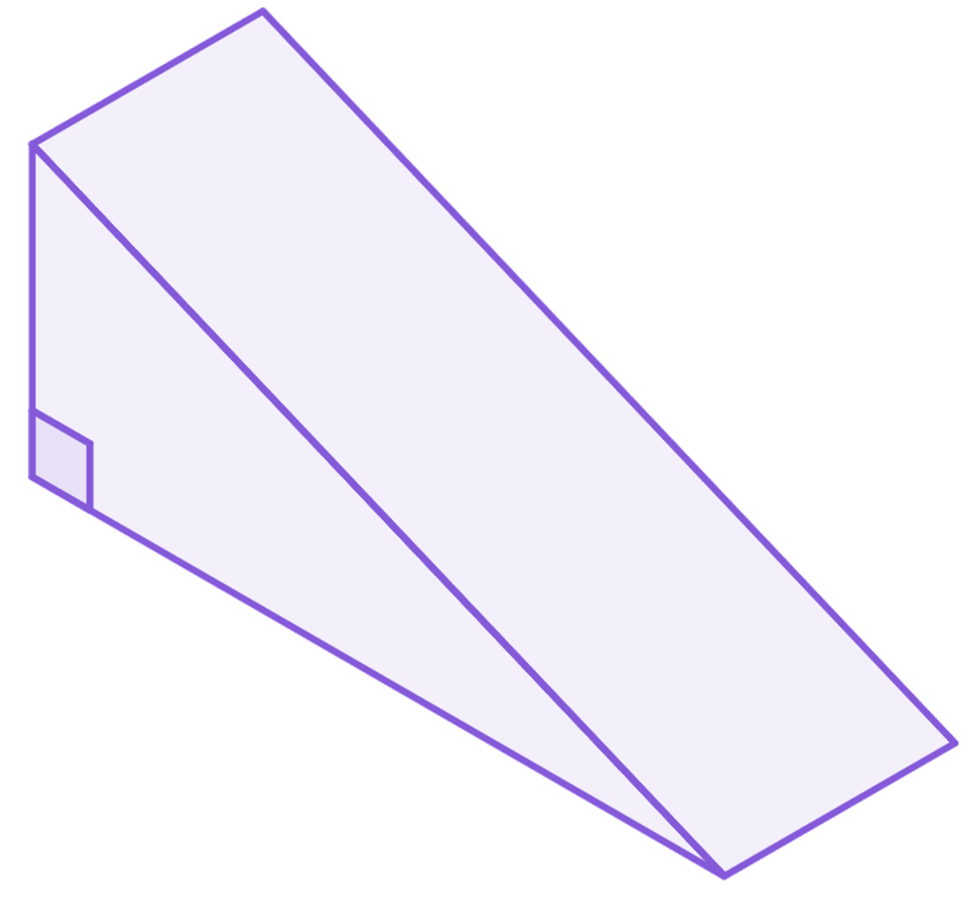
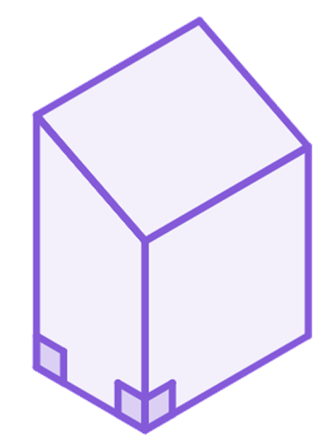
Problem solving with perimeter, area and volume
Task A: Surface area and volume
1) The surface area of this triangular prism is 240 cm².
a) What is the length of the prism?
b) Hence calculate the volume of the prism.
5 cm
13 cm
12 cm
l cm
2) The volume of a cylinder is 324𝜋 cm³ and its height is 9 cm.
Work out the cylinder’s surface area.
5 cm
3) The surface area of this prism is 516 cm².
Work out the volume of the prism.
20 cm
17
cm
4 cm
l cm

Slide 2

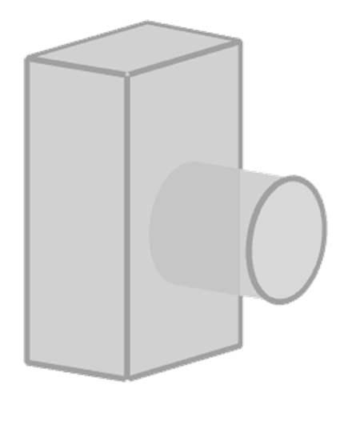
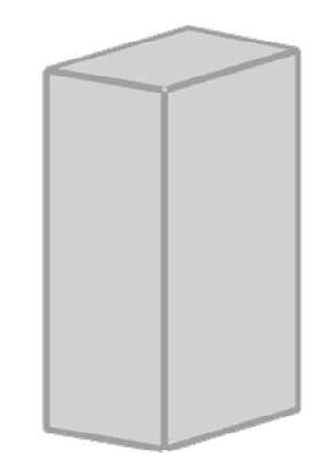
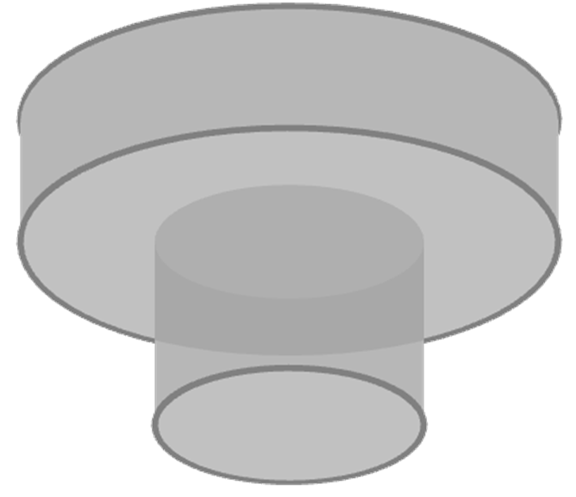

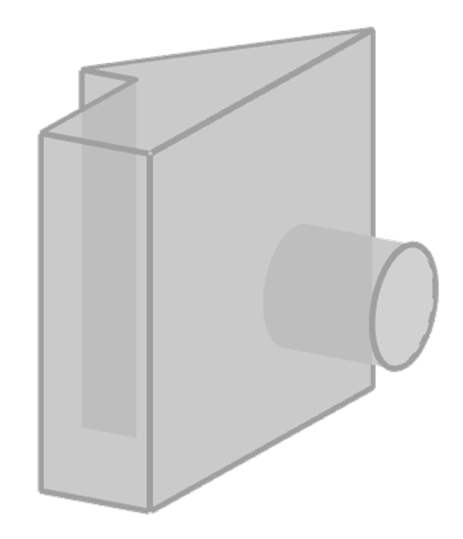
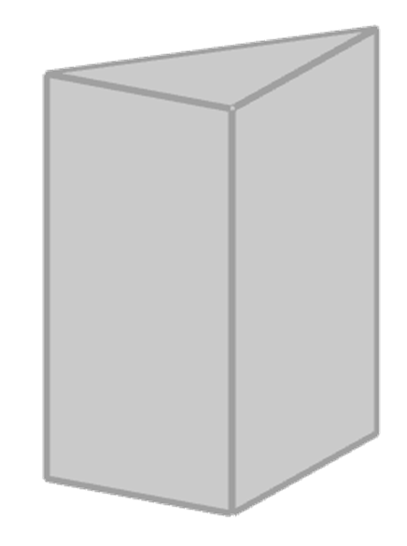
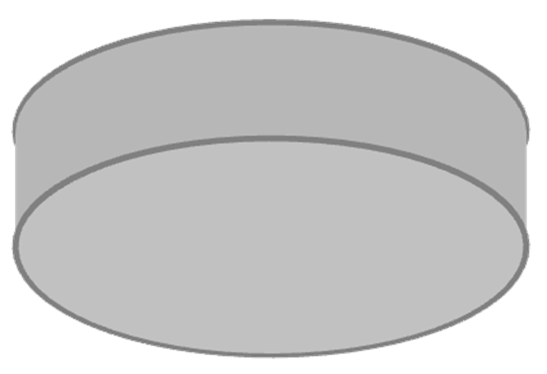
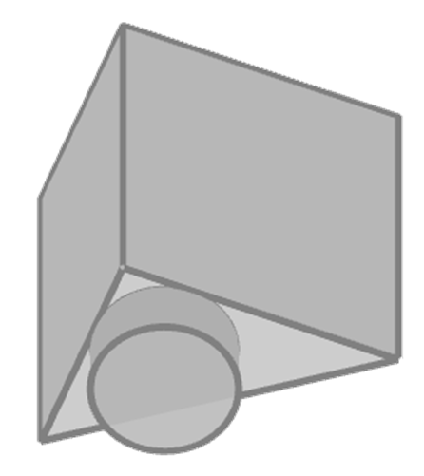
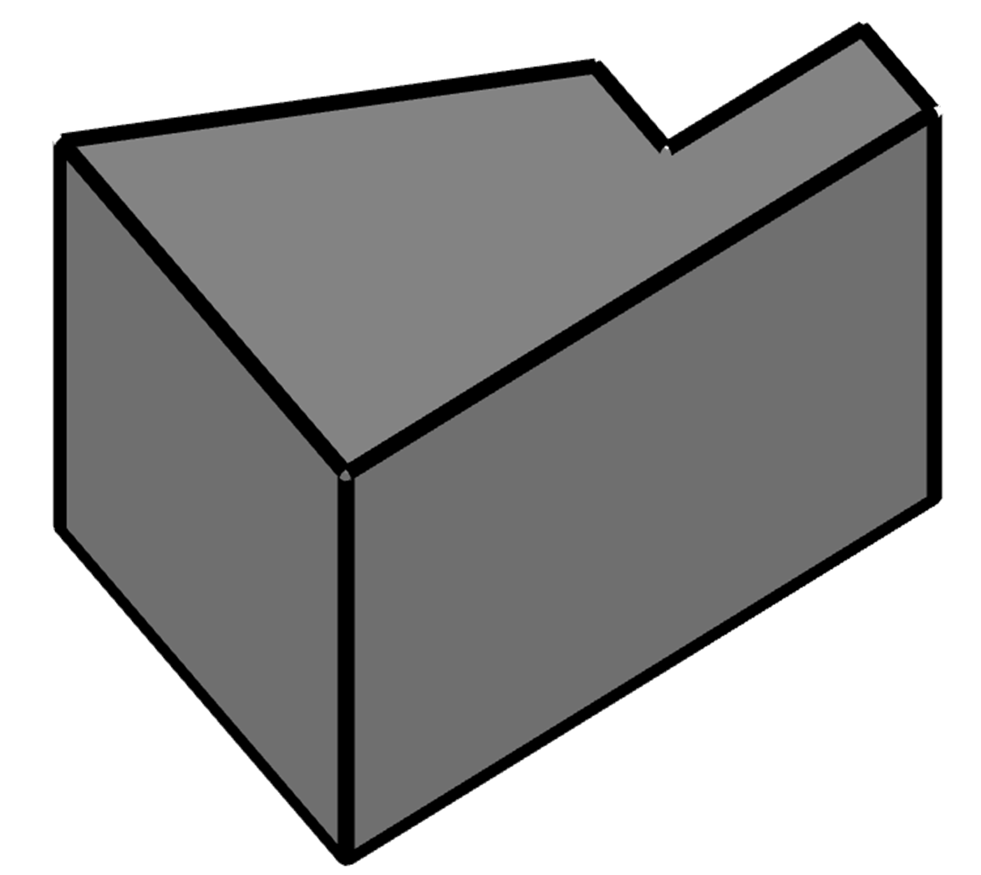
Problem solving with perimeter, area and volume
4) The areas of three faces have been given. The edges are integer amounts of centimetres. What is the volume of this cuboid?
60 cm²
108 cm²
45
cm²
Task B: Composite solids
1) Match the composite solid with its parts.
2) Calculate the volume of this prism.
25 mm
16 mm
8 mm
8 mm
22 mm
23 mm
40 mm

Slide 3
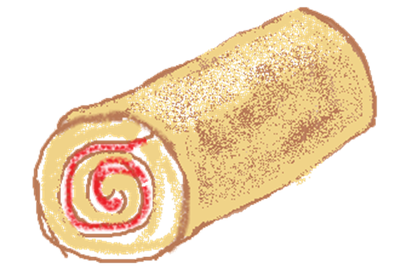
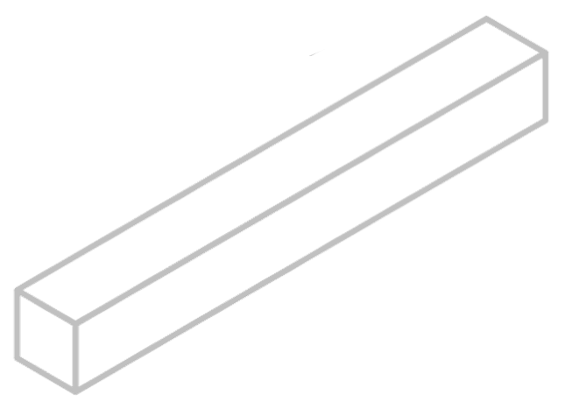
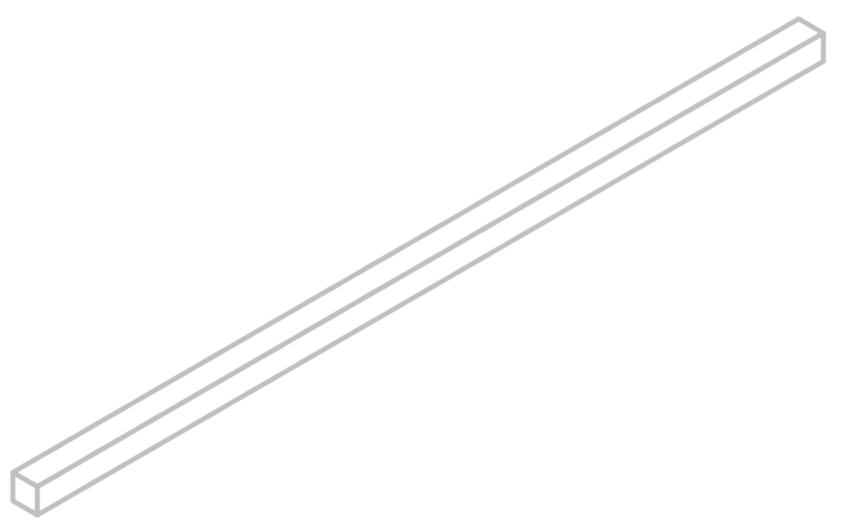
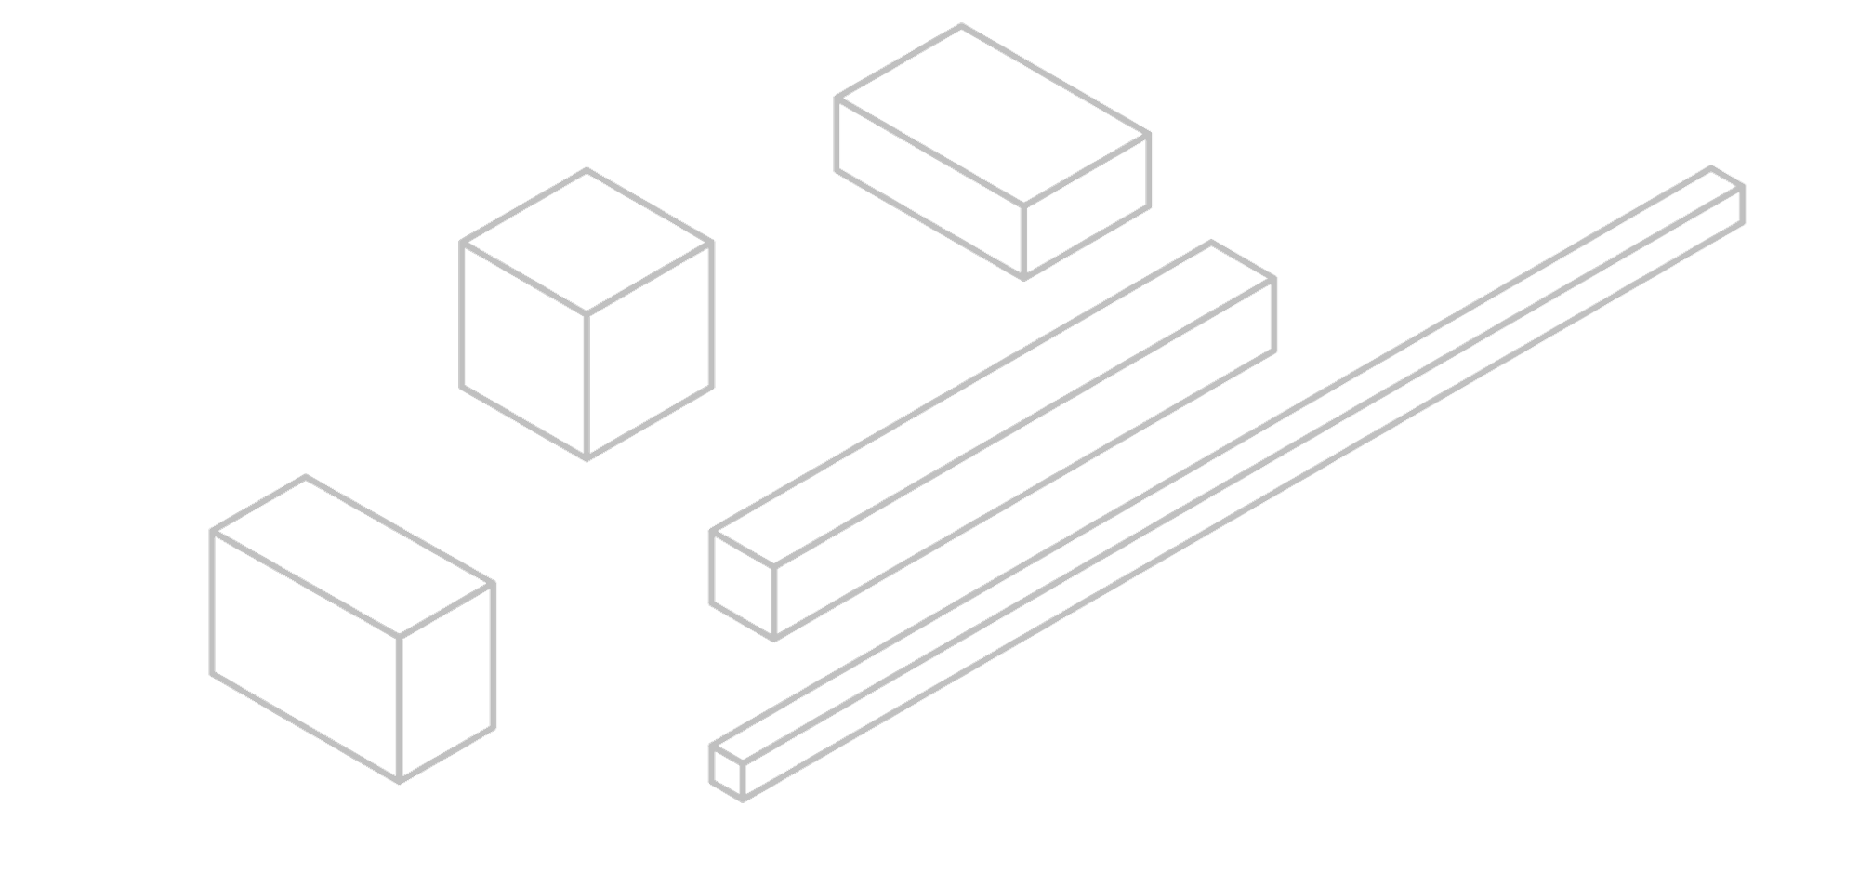

Problem solving with perimeter, area and volume
Task C: Problems in context
1) A baker makes 24 mini swiss rolls and wants to cover them in chocolate. How many square centimetres of chocolate will the baker have used?
8 cm
3 cm
2) A metal pole is melted down and remoulded into cubes with edges of 5 cm. How many cubes can be made from this pole?
45 cm
7 cm
3) One factor that affects the rate of dissolving is the contact between the solute and the solvent.
Here are some sugar lumps (solute) of the same mass. When put in water (solvent),
which would have:
a) the most contact?
b) the least contact?
 | l | w | h
A | 40 | 5 | 5
B | 20 | 10 | 5
C | 10 | 10 | 10
D | 250 | 2 | 2
E | 12.5 | 8 | 10
A
C
B
E
l = length (mm)
w = width (mm)
h = height (mm)
D
Mathematics in Education and Industry.
v2.2

